Slide 1
CS4100: Computer Architecture Memory Hierarchy (I)
Prof. Chung-Ta King
Department of Computer Science
National Tsing Hua University, Taiwan

Slide 2
Outline
Introduction to memory hierarchy (Sec. 5.1)
Memory technologies (Sec. 5.2, 5.5)
Caches (Sec. 5.3, 5.4, 5.9)
Virtual memory (Sec. 5.7)
Framework for memory hierarchy (Sec. 5.8)
Virtual machines (Sec. 5.6)
Parallelism and memory hierarchies: cache coherence, redundant arrays of inexpensive disks (Sec. 5.10, 5.11)

Slide 3
Why Memory Hierarchy?
Programmers want unlimited amounts of memory with low latency
But fast memory more expensive than slower memory
Solution: small fast memory + big slow memory = Looks like a big fast memory
Big
Fast
M_{M}
M_{C}
Small and fast
Big and slow
Notes:
Why does this work?

Slide 4
How to Use Memory Hierarchy?
Entire addressable memory space available in largest, slowest memory
Incrementally smaller and faster memories, each containing a subset of the memory below it, proceed toward processor
Upper level: closer to processor (smaller, faster, expensive)
Lower level: away from processor (bigger, slower, cheap)
Processor chip
Secondary
Storage
(Disk)
Control
Main
Memory
(DRAM)
L2
Cache
Datapath
On-Chip
Cache
Registers

Slide 5
Why Memory Hierarchy Works?
Principle of locality:
Programs access a small proportion of their address space (data and instruction) at any time → a program property
Two types of locality:
Temporal locality: items accessed recently are likely to be accessed again soon, e.g., instructions in a loop
Spatial locality: items near those accessed recently are likely to be accessed soon, e.g., sequential instruction access, array data
Stack
Code
Prob.
Array
Prob.
time
Location

Slide 6
How Does It Work?
Temporal locality: keep most recently accessed data items closer to the processor (faster reuse)
Spatial locality: move blocks consisting of contiguous words to the upper levels (bring in neighbors)
Block (or page): basic unit of data transfer
Minimum unit of data that can either be present or not present in a level of the hierarchy
Lower Level
Memory
To Processor
Upper Level
Memory
From Processor
Block Y
Notes:
The design goal is to present the user with as much memory as is available in the cheapest technology (points to the disk).
While by taking advantage of the principle of locality, we like to provide the user an average access speed that is very close to the speed that is offered by the fastest technology.
(We will go over this slide in details in the next lecture on caches).
+1 = 16 min. (X:56)

Slide 7
Levels of Memory Hierarchy
Capacity
Access Time
Management
Unit
CPU
Upper Level
CPU Registers
100s Bytes <1s cycle
faster
Registers
prog./compiler
1-8 bytes
Instr. operands
Cache
M Bytes
10s cycles
Cache
cache controller
8-128 bytes
Blocks
Main Memory
G Bytes
100s cycles
Memory
OS
512-1M bytes
Pages
Disk
T Bytes
1M cycles
Disk
Larger
Lower Level

Slide 8
Hit or Miss
Hit: accessed data appears in upper level
Hit rate: % of memory accesses found in upper level
Hit time: time to access upper level
Miss: data not in upper level
Miss rate = 1 - (hit rate)
Miss penalty: time to replace a block in upper level + time to deliver the block to the processor
Hit Time << Miss Penalty
Lower Level
Memory
miss
Upper Level
Memory
From Processor
Blk X
Blk Y
To Processor
Notes:
A HIT is when the data the processor wants to access is found in the upper level (Blk X).
The fraction of the memory access that are HIT is defined as HIT rate.
HIT Time is the time to access the Upper Level where the data is found (X). It consists of:
(a) Time to access this level.
(b) AND the time to determine if this is a Hit or Miss.
If the data the processor wants cannot be found in the upper level, then we have a miss and we need to retrieve the data (Blk Y) from the lower level.
By definition (definition of Hit: Fraction), the miss rate is just 1 minus the hit rate.
This miss penalty also consists of two parts:
(a) The time it takes to replace a block (Blk Y to BlkX) in the upper level.
(b) And then the time it takes to deliver this new block to the processor.
It is very important that your Hit Time to be much much smaller than your miss penalty. Otherwise, there will be no reason to build a memory hierarchy.
+2 = 14 min. (X:54)

Slide 9
4 Questions for Memory Hierarchy Design
Q1: Where can a block be placed in the upper level?
One fixed location, a few locations, anywhere
Q2: How is a block found if it is in the upper level?
Depending on strategy taken in Q1
Indexing, table lookup, parallel search
Q3: Which block should be replaced on a miss?
Ideal: one that not to be used in the farthest future
Practical: use the past to predict the future → how to “track” the past?
Q4: What happens on a write?
Write to upper level only or to lower level as well
What if write miss?

Slide 10
Summary of Memory Hierarchy
Two different types of locality:
Temporal locality (locality in time)
Spatial locality (locality in space)
Using the principle of locality:
Present the user/program with as much memory as is available in the cheapest technology
Provide access at the speed offered by the fastest memory
End result: provide user/program an illusion of a big fast random access memory
Notes:
The first thing we covered is the principle of locality.
There are two types of locality: temporal, or locality of time and spatial, locality of space.
We talked about memory system design.
The key idea of memory system design is to present the user with as much memory as possible in the cheapest technology while by taking advantage of the principle of locality, create an illusion that the average access time is close to that of the fastest technology.
As far as Random Access technology is concerned, we concentrate on 2: DRAM and SRAM.
DRAM is slow but cheap and dense so is a good choice for presenting the use with a BIG memory system.
SRAM, on the other hand, is fast but it is also expensive both in terms of cost and power, so it is a good choice for providing the user with a fast access time.
+2 = 78 min. (Y:58)

Slide 11
Outline
Introduction to memory hierarchy (Sec. 5.1)
Memory technologies (Sec. 5.2, 5.5)
Dependable memory hierarchy (Sec. 5.5)
Caches (Sec. 5.3, 5.4, 5.9)
Virtual memory (Sec. 5.7)
Framework for memory hierarchy (Sec. 5.8)
Virtual machines (Sec. 5.6)
Parallelism and memory hierarchies: cache coherence, redundant arrays of inexpensive disks (Sec. 5.10, 5.11)

Slide 12
Memory Technology
Random access: access time same for all locations
Can access any random location at any time
SRAM: Static Random Access Memory
Store bits like a flip-flop → content will last until lose power
Low density, high power, expensive, fast
Used for caches
DRAM: Dynamic Random Access Memory
Store bits in capacitor charges → charges will leak and eventually disappear ➔ dynamic
High density, low power, cheap, slow
Used for main memory
Word Line (Control)
Bit Line (Data)
Storage Capacitor
Notes:
The technology we used to build our memory hierarchy can be divided into two categories: Random Access and Non-so-Random Access.
Because random access means you can access any random location at any time and the access time will be the same as any other random locations.
Which is NOT the case for disks or tape where the access time for a given location at any time can be quite different from some other random locations at some other random time.
As far as Random Access technology is concerned, we will concentrate on two specific technologies: Dynamic RAM and Static RAM.
The advantages of Dynamic RAMs are high density, low cost, and low power so we can have a lot of them without burning a hole in our budget or our desktop.
The disadvantages of DRAM are they are slow. Also they will forget what you tell them if you don remind them constantly (Refresh). We will talk more about refresh later today.
SRAM only has one redeeming feature: it is fast. Other than that, they have low density, expensive, and burn a lot of power. Oh, SRAM actually has another redeeming feature. They will not forget what you tell them. They will keep whatever you write to them forever.
Well orever?is a long time. So lets just say it will keep your data as long as you don pull the plug on your computer.
In the next two lectures, we will be focusing on DRAMs and SRAMs.
We will not get into disk until the Virtual Memory lecture a week from now.
+3 = 19 min. (X:59)

Slide 13
Comparisons of Memory Technologies
Ideal memory
Access time of SRAM
Capacity and cost/GB of disk
Memory technology | Typical access time | $ per GB in 2008
SRAM | 0.5 ~ 2.5 ns | $2000 ~ $5,000
DRAM | 50 ~ 70 ns | $20 ~ $75
Magnetic disk | 5 ~ 20 ms | $0.20 ~ $2

Slide 14
DRAM Technology
Data stored as a charge in a capacitor
Single transistor used to access the charge
Destructive read and need to write back
Bits are organized as a rectangular array
An entire row is accessed into a row buffer
Must periodically be refreshed
Read contents and write back
Performed on a DRAM row
Word Line (Control)
Bit Line (Data)
Storage Capacitor
bitline
Row addr decoder
Row addr
Col. addr
wordline
Address
Col. addr
decoder
Row buffer
Data out

Slide 15
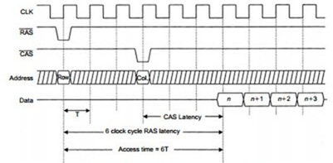
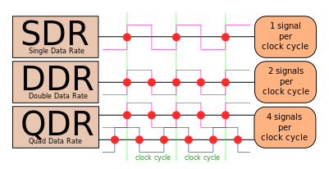
Advanced DRAM Organizations
Burst mode:
Supply successive words from row buffer → reduce latency
Synchronous DRAM:
Clocking DRAM interface for repeated transfers without handshaking overhead
Double data rate (DDR) DRAM
Transfer on rising and falling clock edges
DRAM banking:
Multiple DRAM banks allowing simultaneous accesses (next slide)
https://en.wikipedia.org/wiki/Double_data_rate

Slide 16
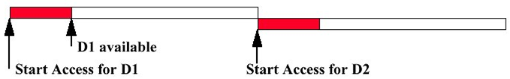
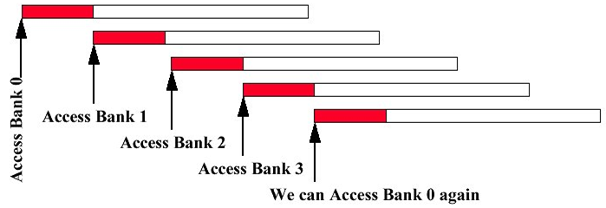
DRAM Banking
One memory bank
Four interleaved memory banks
Pipelined access for increased bandwidth
CPU
Memory
Memory Bank Cycle Time
Memory bank 0
Memory bank 1
CPU
Memory bank 2
Memory bank 3
https://people.rit.edu/meseec/cmpe550-spring2018/

Slide 17
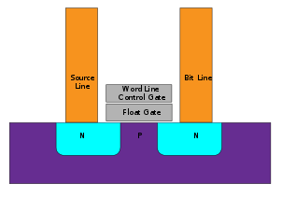
Flash Storage
Nonvolatile semiconductor storage
100× ~ 1000× faster than disk
Smaller, lower power, more robust, more $/GB
Store bits in floating-gate transistors
Apply a voltage V_{T1}< V < V_{T2} to CG: if transistor on → FG uncharged → a logic “1” is stored
Floating gate (FG) traps charges and changes threshold voltage (V_{T1}→V_{T2}) at control gate (CG) to turn on transistor
(By Cyferz at English Wikipedia, CC BY 2.5, https://commons.wikimedia.org/w/index.php?curid=47813471)
Notes:
In order to read a value from the transistor, an intermediate voltage between the threshold voltages (V_{T1} & V_{T2}) is applied to the CG. If the channel conducts at this intermediate voltage, the FG must be uncharged (if it was charged, we would not get conduction because the intermediate voltage is less than V_{T2}), and hence, a logical "1" is stored in the gate. If the channel does not conduct at the intermediate voltage, it indicates that the FG is charged, and hence, a logical "0" is stored in the gate.

Slide 18
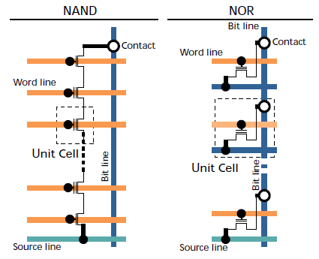
Flash Storage
NOR flash: bit cell like a NOR gate
Random read/write access
Used for instruction memory in embedded systems
NAND flash: bit cell like a NAND gate
Denser and cheaper, block-at-a-time access
Used for USB keys, media storage, …
Flash bits wears out after 1000’s of accesses
Wear leveling: remap data to less used blocks
H
|
L
X
H
|
H’
|
H’
_
H
|
H
|
L
X
Notes:
In NOR Flash, cells are connected in parallel to the bit lines, which allow the cells to be read and programmed individually. NOR flash acts like a NOR gate, when one of the word lines (connected to the cell's CG) is brought high, the corresponding storage transistor acts to pull the output bit line low. A NOR flash cell can be programmed, or set to a binary "0" value, by the following procedure:
* an elevated on-voltage (typically >5 V) is applied to the CG
* the channel is now turned on, so electrons can flow from the source to the drain (assuming an NMOS transistor)
* the source-drain current is sufficiently high to cause some high energy electrons to jump through the insulating layer onto the FG, via a process called hot-electron injection.
In NAND Flash, the cells are connected in series, resembling a NAND gate: several transistors are connected in series, and the bit line is pulled low only if all the word lines are pulled high (above the transistors' V_{T}). These groups are then connected via some additional transistors to a NOR-style bit line array in the same way that single transistors are linked in NOR flash. The series connections consume less space than the parallel ones, reducing the cost of NAND Flash. It does not, by itself, prevent NAND cells from being read and programmed individually. (https://www.researchgate.net/figure/Comparison-of-NOR-Flash-array-and-NAND-Flash-array-architectures_fig8_265727614)

Slide 19
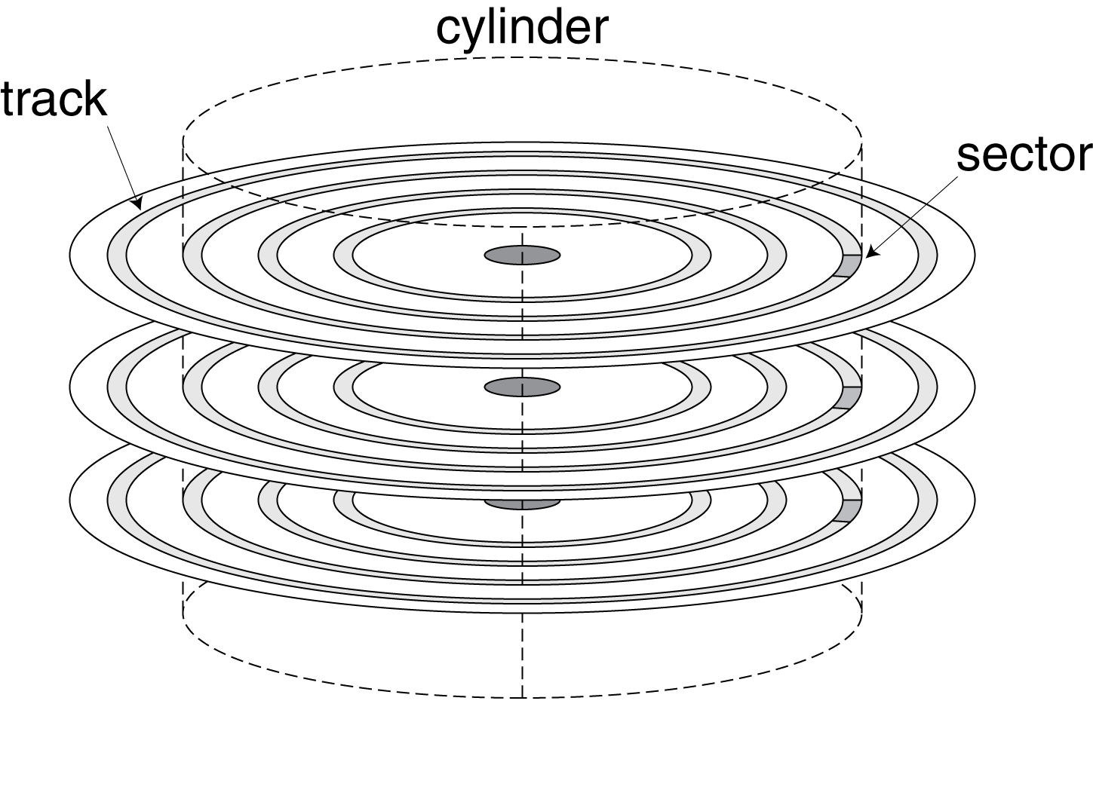
Disk Storage
Nonvolatile, rotating magnetic storage
Spindle
Arm
Head
Actuator
Platters

Slide 20
Disk Sectors and Access
Each sector records
Sector ID
Data (512 bytes, 4096 bytes proposed)
Error correcting code (ECC)
Used to hide defects and recording errors
Synchronization fields and gaps
Access to a sector involves
Queuing delay: if other accesses are pending
Seek time: time to move the heads to desired track
Rotational latency: time for desired sector under head
Data transfer: time to transfer desired sector
Controller overhead
Track
Sector
Cylinder
Platter
Head

Slide 21
Disk Access Example
Given
512B sector, 15,000rpm, 4ms average seek time, 100MB/s transfer rate, 0.2ms controller overhead, idle disk
Average read time
4ms seek time + ½ / (15,000/60) = 2ms rotational latency + 512 / 100MB/s = 0.005ms transfer time + 0.2ms controller delay = 6.2ms
If actual average seek time is 1ms
Average read time = 3.2ms

Slide 22
Outline
Introduction to memory hierarchy (Sec. 5.1)
Memory technologies (Sec. 5.2, 5.5)
Dependable memory hierarchy (Sec. 5.5)
Caches (Sec. 5.3, 5.4, 5.9)
Virtual memory (Sec. 5.7)
Framework for memory hierarchy (Sec. 5.8)
Virtual machines (Sec. 5.6)
Parallelism and memory hierarchies: cache coherence, redundant arrays of inexpensive disks (Sec. 5.10, 5.11)

Slide 23
Is Your Memory Reliable?
What is failure?
Given a specification of proper service (of memory)
Fault: failure of a component, may or may not cause failure
Service accomplishment
Service delivered as specified
Failure may be permanent or intermittent
Restoration
Failure
Service interruption
Deviation from specified service

Slide 24
Reliability vs. Availability
Reliability: a measure of continuous service accomplishment (or the time to failure), starting from a reference point
Mean time to failure (MTTF): a reliability measure
Mean time to repair (MTTR): a measure of service interruption
Mean time between failures (MTBF): = MTTF + MTTR
Availability: a measure of service accomplishment with respect to the alternation between the two states of accomplishment and interruption
Availability = MTTF / (MTTF + MTTR)

Slide 25
Reliability vs. Availability
We want high availability (HA)
Can be expressed as # of “nines of availability” per year
One nine: 90% → 36.5 days of repair/year
Five nines: 99.999% → 5.26 minutes of repair/year
HA can be achieved by
Reducing MTTR: improved tools and processes for fault detection, diagnosis and repair
Increasing MTTF: improve quality of components or design systems to continue operation in the presence of components that have failed
Fault avoidance: reliable components
Fault tolerance: redundant components
Fault forecasting: predict and replace before failure

Slide 26
Fault Tolerance for Memory
Hamming Single Error Correcting, Double Error Detecting Code (SECDED)
Hamming distance:
Minimum number of bits that are different between any two correct bit patterns
A measure of how “close” correct bit patterns can be
e.g., Hamming distance between 011011 and 001111 is two
Single Error Detecting Code:
A set of legal bit patterns that can detect single bit error
11
10
01
00
Notes:
Richard Hamming

Slide 27




Single Error Detecting Code
The simplest way to encode four different things:
Suppose you send the code “01” to ask your friend to bring you a banana, but the code was erroneously transmitted as “11” → Can she/he tell there is a bit error?
How about this code?
→ 00
→ 01
→ 10
→ 11
→ 000
→ 011
Why it works?
→ 101
→ 110
Notes:
the parity of the N+1 bit word should always be even

Slide 28
Single Error Detecting Code
Hamming distance of 3-bit codes
A link between two codes whose Hamming distance = 1
Single Error Detecting Code:
Condition: if only every pair of legal bit patterns has a Hamming distance of 2, e.g., parity code
111
110
101
011
Legal bit patterns are actually
original codes (00, 01, 10, 11) plus even parity (bit 0)
100
010
001
000
But, which bit is in error?

Slide 29
Single Error Correcting (SEC) Code
A code with a Hamming distance of 3 provides single error correction (Why?)
111
110
101
011
100
010
001
000

Slide 30
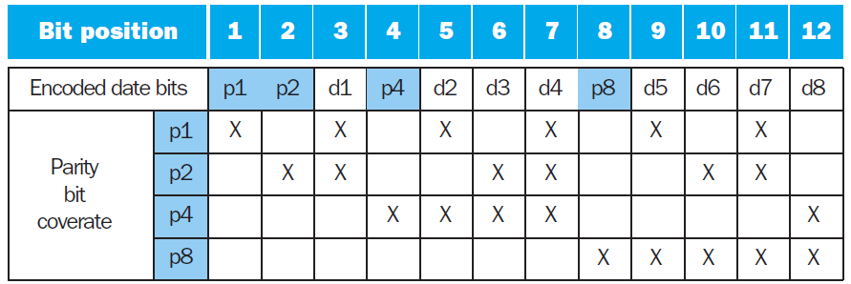
Single Error Correcting (SEC) Code
Hamming Error Correction Code (ECC):
Number bits from 1 on the left
All bit positions that are a power 2 are parity bits
Each parity bit checks group of data bits via even parity:
Fig. 5.24
Notes:
■ Bit 1 (0001_{two}) checks bits (1,3,5,7,9,11,...), which are bits where rightmost bit of address is 1 (0001_{two}, 0011_{two}, 0101_{two}, 0111_{two}, 1001_{two}, 1011_{two},…).
■ Bit 2 (0010_{two}) checks bits (2,3,6,7,10,11,14,15,…), which are the bits where the second bit to the right in the address is 1.
■ Bit 4 (0100_{two}) checks bits (4–7, 12–15, 20–23,...) , which are the bits where the third bit to the right in the address is 1.
■ Bit 8 (1000_{two}) checks bits (8–15, 24–31, 40–47,...), which are the bits where the fourth bit to the right in the address is 1.

Slide 31
Single Error Correcting (SEC) Code
Sum of positions of erroneous parity bits identifies the erroneous bit, e.g.,
Erroneous parity bits = 0000 indicates no error
Erroneous parity bits = 1001 → bit 1+8=9 was flipped
Example 1:
Encode 10011010₂ → _ _ 1 _ 0 0 1 _ 1 0 1 0?
Position 1 should make bits 1, 3, 5, 7, 9, 11 even parity _ _ 1 _ 0 0 1 _ 1 0 1 0 → p1 = 0
Final code word = 011100101010
If we detect bit pattern 011100101110, which bit is error?
Groups protected by p1 and p4 are even parity
But, groups protected by p2 and p8 are odd parity → 2 + 8 = 10 and the 10th bit is in error and can be corrected
How to tell if 1- or 2-bit error?
Notes:
If 1-bit error for sure, we can correct it. But, if it is possible to be 2-bit error, …?

Slide 32
Single Error Correcting (SEC) Code
Example 2:
Consider the code word = 011100101010
If we detect bit pattern 011100001010, which bit is error?
Bits 1, 3, 5, 7, 9, 11 should be even parity, but they are not 0 1 1 1 0 0 0 0 1 0 1 0 → H = h₁h₂h₄h₈ = 1 _ _ _
Bits 2, 3, 6, 7, 10, 11 should be even parity, but they are not 0 1 1 1 0 0 0 0 1 0 1 0 → H = h₁h₂h₄h₈ = 1 1 _ _
Bits 4, 5, 6, 7, 12 should be even parity, but they are not 0 1 1 1 0 0 0 0 1 0 1 0 → H = h₁h₂h₄h₈ = 1 1 1 _
Bits 8, 9, 10, 11, 12 should be even parity, and they are 0 1 1 1 0 0 0 0 1 0 1 0 → H = h₁h₂h₄h₈ = 1 1 1 0
1 + 2 + 4 = 7 and the 7th bit is in error and can be corrected
Example 3:
How about this bit pattern: 011100111010?
Notes:
If 1-bit error for sure, we can correct it. But, if it is possible to be 2-bit error, …?

Slide 33
SECDED
Single error correcting, double error detecting (SECDED)
Add an additional parity bit for the whole word (p_{n})
Final code word = 011100101010 0
This makes Hamming distance = 4 (so?)
Decoding: let H = h₁h₂h₄h₈ and h _{n} = parity of whole word
H = 0, h_{n} even → no error
H ≠ 0, h_{n} odd → correctable single bit error (as in SEC)
H = 0, h_{n} odd → error in p_{n} bit
H ≠ 0, h_{n} even → double error occurred
Note: ECC DRAM uses SECDEC with 8 bits to protect each 64-bit data in memory

Slide 34
SECDED
Example 1: detect bit pattern = 011100001010 0
We have shown that H = h₁h₂h₄h₈ = 1 1 1 0
In addition, the whole word is odd parity → h_{n} = odd
So, H ≠ 0, p_{n} odd → correctable single bit error at bit 7
Example 2: detect bit pattern = 011100011010 0
0 1 1 1 0 0 0 1 1 0 1 0 → H = h₁h₂h₄h₈ = 1 _ _ _
0 1 1 1 0 0 0 1 1 0 1 0 → H = h₁h₂h₄h₈ = 1 1 _ _
0 1 1 1 0 0 0 1 1 0 1 0 → H = h₁h₂h₄h₈ = 1 1 1 _
0 1 1 1 0 0 0 1 1 0 1 0 → H = h₁h₂h₄h₈ = 1 1 1 1
The whole word is even parity → h_{n} = even
So, H ≠ 0, h_{n} even → double error

